Slide 1
DISCLAIMER ALERT!!
This video is designed for information, education and demonstration purpose and it is not a medical advice .Self diagnosis and self treatment is not recommended, consult a healthcare professional before doing anything described in the video. Dr. Pooja Dhamija PT is not liable for any advice, treatment or any other information obtained through this video.

Slide 2
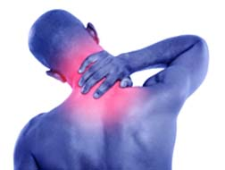
POSTURE RELATED NECK PAIN
NECK PAIN WITH HEADACHE

Slide 3
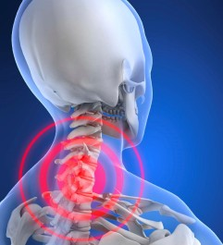
POSTURE RELATED NECK PAIN
Poor posture
strain in muscles, ligaments
results in injury over the time

Slide 4
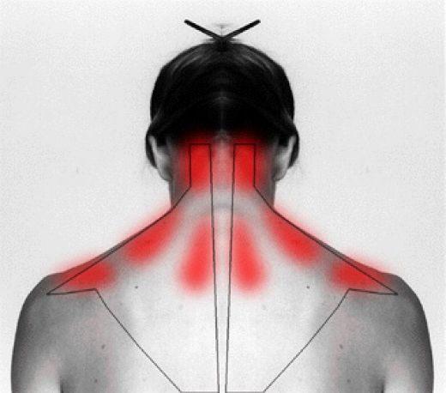
HEAD AND SHOULDER FORWARD POSTURE
Starts with rounded shoulders
Increases stress on shoulder
Pain around the head, neck, upper back

Slide 5
PREVENTION AND MODIFICATIONS
Maintain good posture while using mobile and laptops.
Do not cradle mobile phone between your ear and shoulder.
Do not use mobile phones for long duration at a stretch. Limit its use to 20 min sessions.
Take frequent microbreaks when you work for a long duration in a particular position.

Slide 6
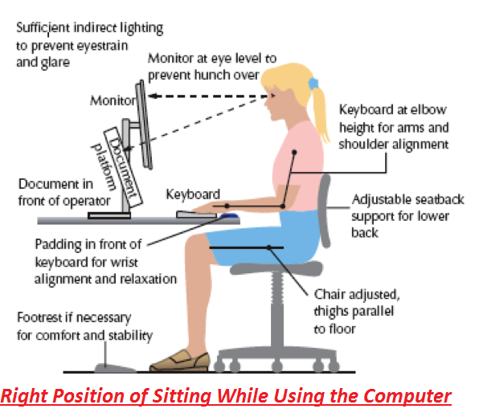
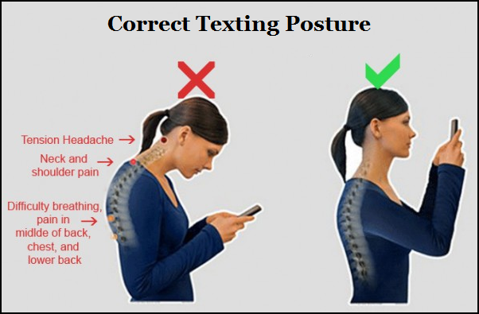
Maintain good posture while using mobile ,computer, laptops.

Slide 7
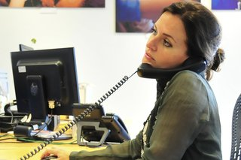
Do not cradle mobile phone between your ear and shoulder.

Slide 8
PREVENTION AND MODIFICATIONS
Do not use mobile phones for long duration at a stretch. Limit its use to 20 min sessions.
Take frequent microbreaks when you work for a long duration in a particular position.

Slide 9
EXERCISES ,STRETCHES
Chin Tuck In
Neck Isometrics
Upper trapezius stretch
Levator scapulae stretch
Shoulder blade squeeze (Brugger’s Relief Pose)

